Slide 1

NBA Management System
Presented by:
GROUP 8
Team Members:
Aditi Deshmukh
Li Ning
Rugved Gundawar
Vinay Pawar
Tanmay Chandan
Professor Manuel Montrond

Slide 2

Overview
Data-driven Decision Making
Improved Operations
Enhanced Outcomes
The system addresses challenges related to performance tracking, strategy planning, and game management, optimizing operational efficiency.
The NBA Database Management System facilitates efficient data management and analytics, enabling real-time access to essential information.
By leveraging data-driven insights, the system empowers teams to make informed decisions, contributing to better outcomes both on and off the court.

Slide 3
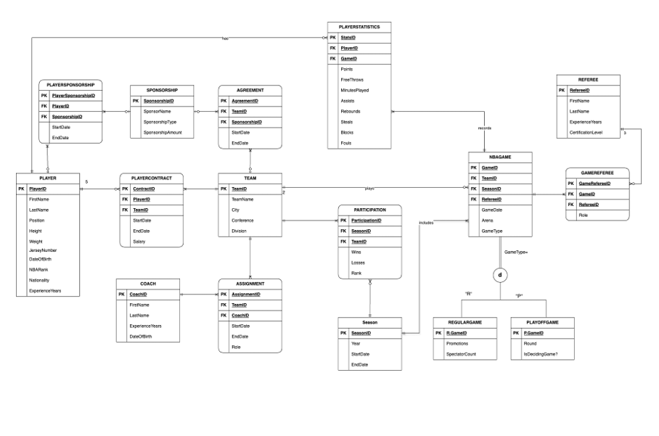
Entity- Relationship Diagram

Slide 4

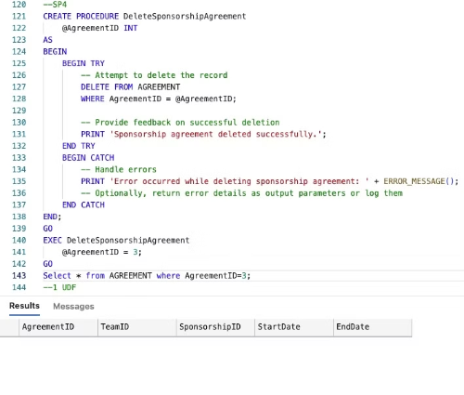
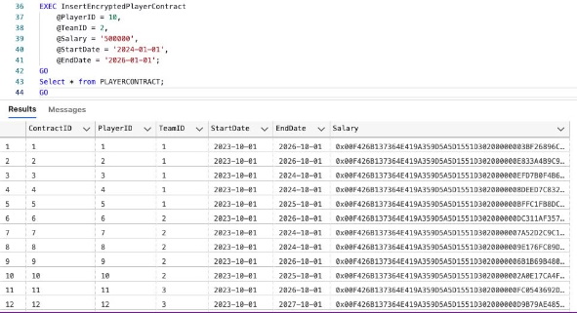
Stored Procedures

Slide 5
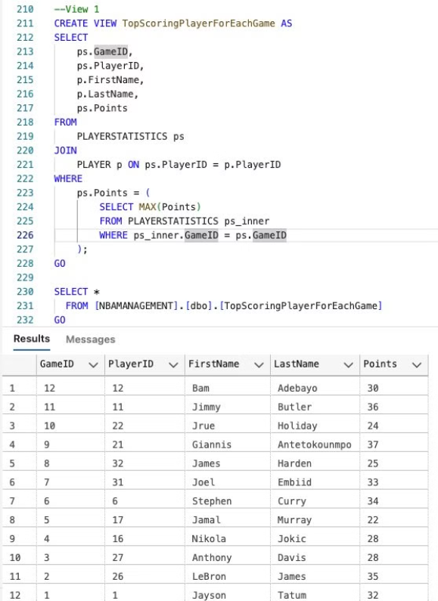
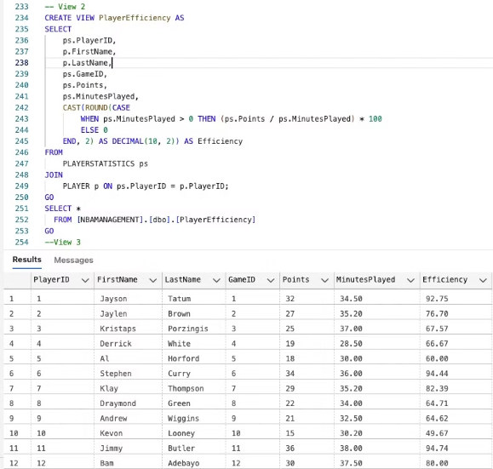
Views

Slide 6
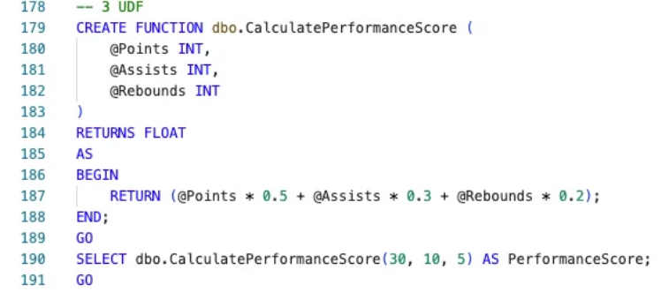
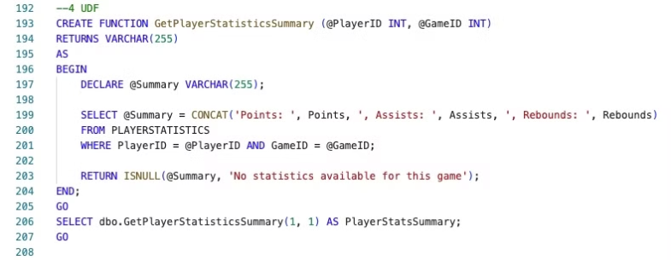
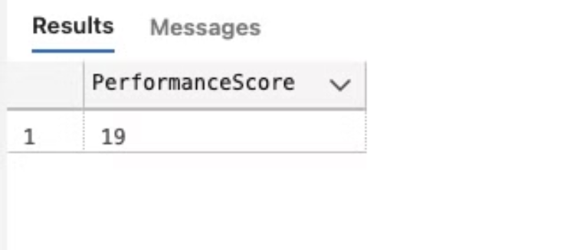
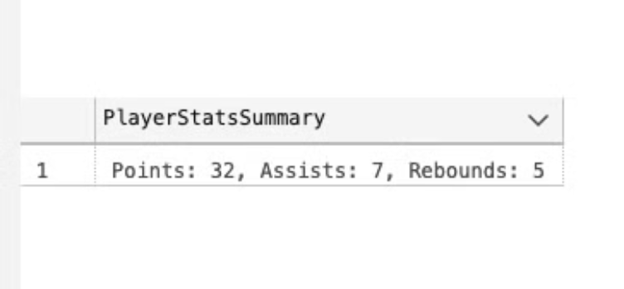
User-defined Functions

Slide 7
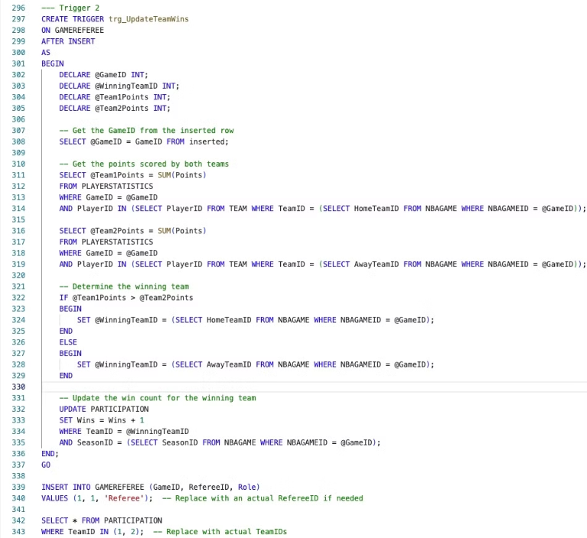

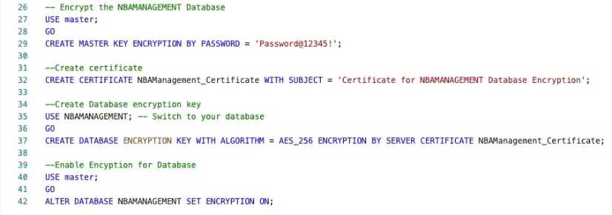
Triggers and Encryption

Slide 8
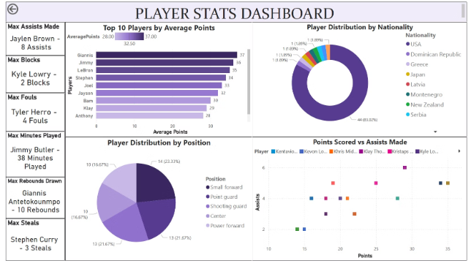
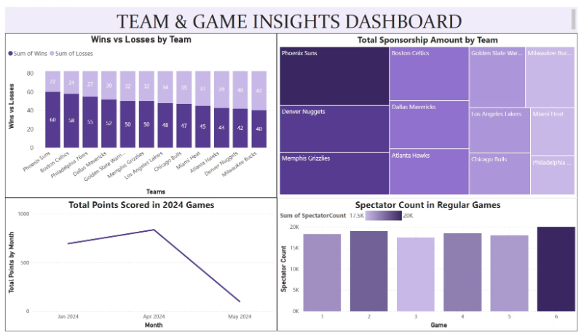
Visualization using Power BI

Slide 9

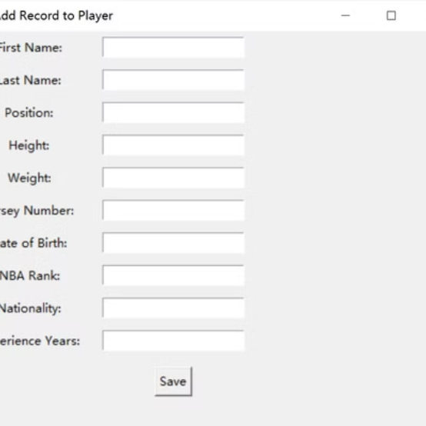
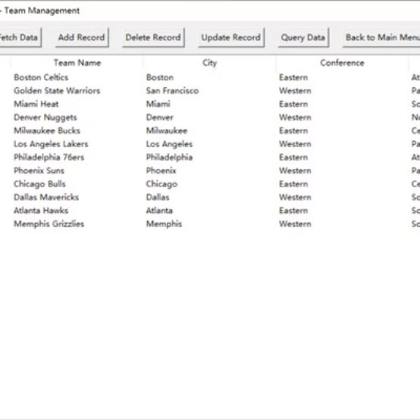
Graphical User Interface

Slide 10

Thank You
This NBA Management System is designed to streamline data management and analysis, supporting NBA teams in achieving operational efficiency and maximizing on and off-court performance.

